Slide 1
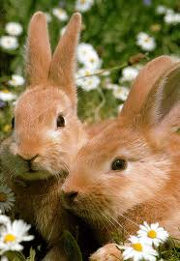
Meet Floppy and Jasmine
Notes:
Find the handout attached with it.
It is a group problem (groups of 3) solving activity, which will take a whole lesson.

Slide 2
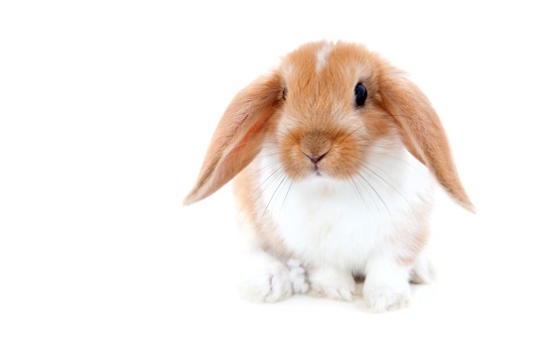
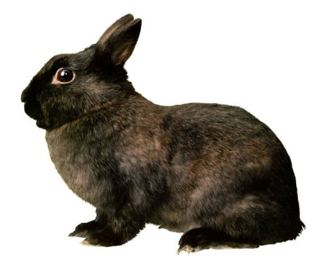
You have just been employed at your local pet shop, and your first customer is your maths teacher.
I need a rabbit hutch – simple.
I do however, have specific requirements.
My rabbits Floppy and Jasmine like lots of room to hop around in – at least 120m³
Obviously the more room the better but my garden is very small so I can only fit a hutch which is 160m³ or less
I would prefer something that looks exciting and not just a boring cuboid shaped one; if the hutch is cuboid shaped – I want it to have something attached to it to make it look nicer.
I can afford to spend up to £105, but that includes the hutch and the accessories for it. I need to also buy sawdust, a food bowl and a water bottle.
You can work with another colleague, providing they share their desk with you at work. However, that means you have to split the commission.

Slide 3
